Slide 1

I Ain’t No Data Scientist
Why Do I Need Jupyter Notebooks?
@SQLDBAWithBeard SqlDbaWithABeard.com Rob Sewell beard.media/book

Slide 2

Rob Sewell
Bearded Consultant
Automator
Trainer
Dual MVP
Consultant Sewells Consulting Ltd
dbatoolsMoL dbachecks
ADSNotebooks PowerShell Community
Data Community
beard.media\book
@sqldbawithbeard
SQLDBAWithABeard.com

Slide 3
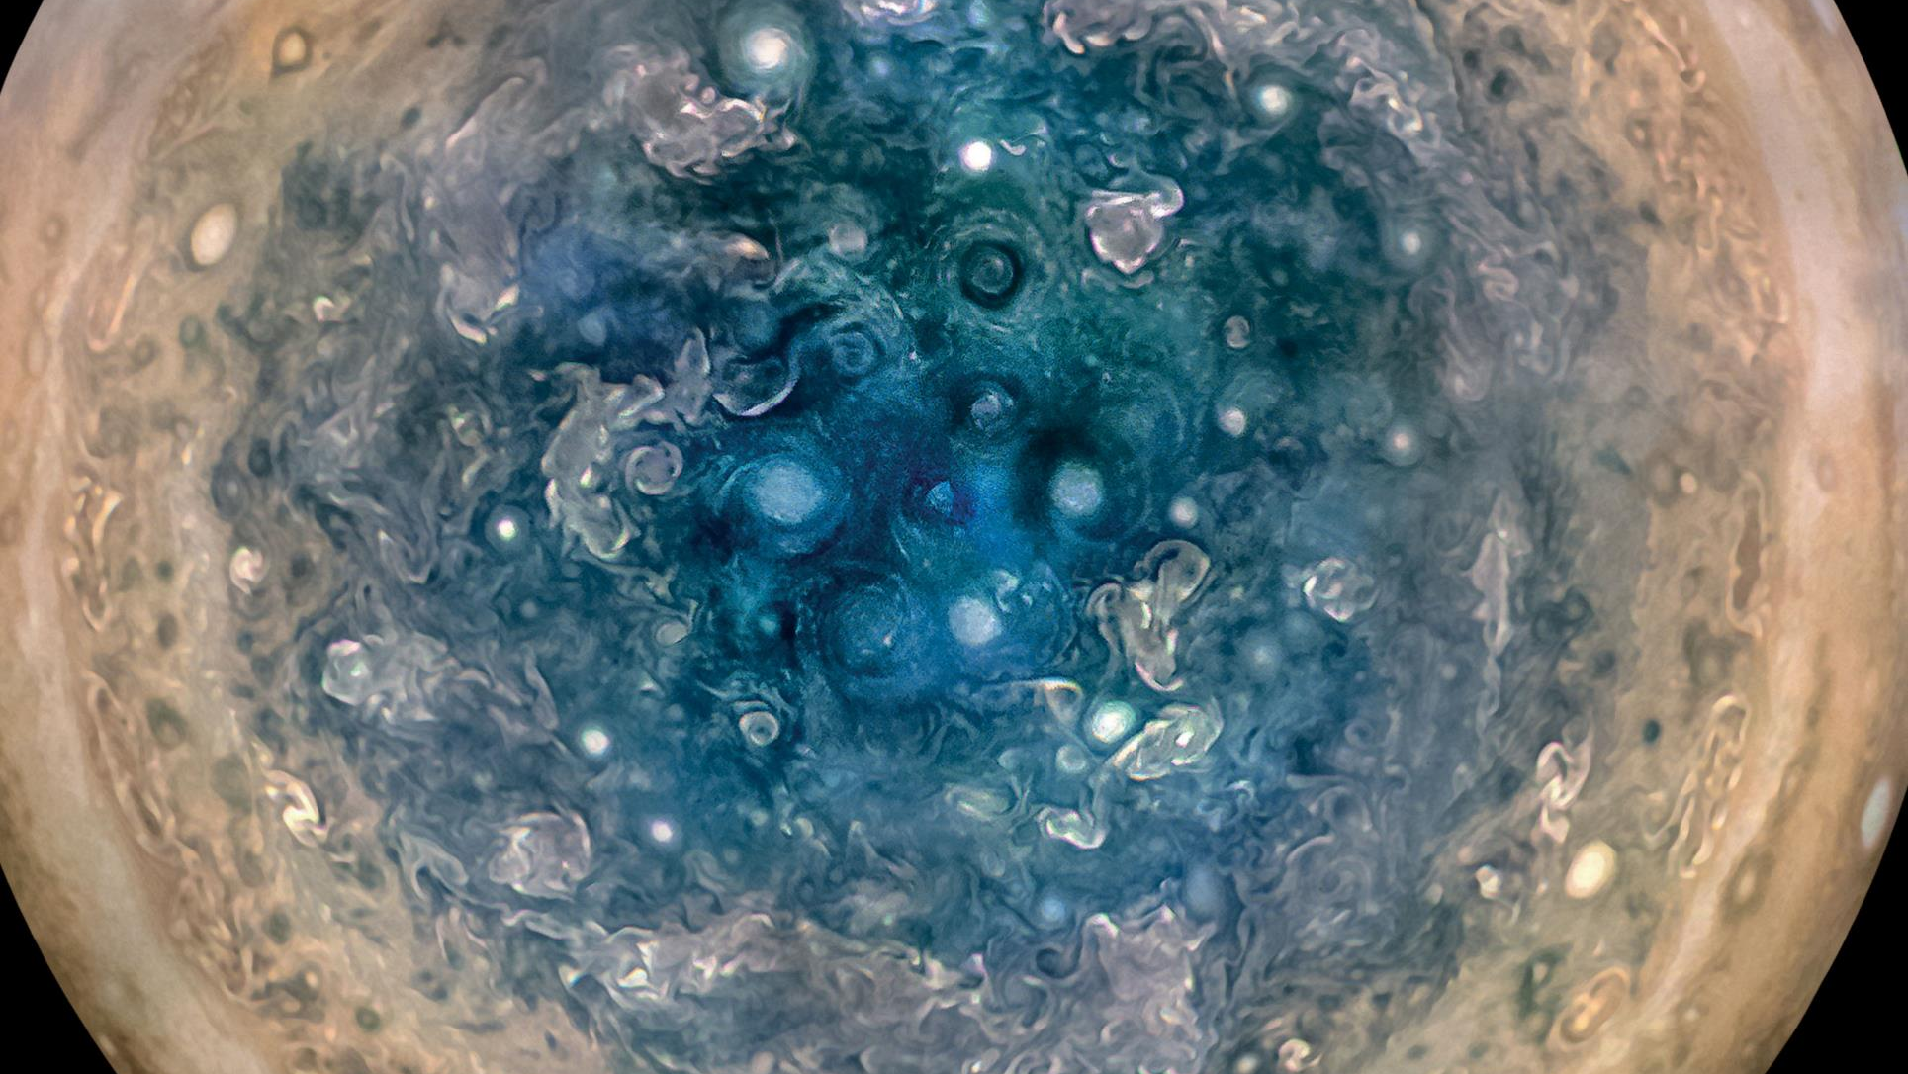

Slide 4
First, the names comes from the planet Jupiter. We wanted to pick a name that evoked the traditions and ideas of science.
Jupyter
@SQLDBAWithBeard SqlDbaWithABeard.com Rob Sewell beard.media/book

Slide 5
Jupyter
First, the names comes from the planet Jupiter. We wanted to pick a name that evoked the traditions and ideas of science.
Second, the core programming languages supported by Jupyter are Julia, Python and R. While the name Jupyter is not a direct acronym for these languages, it nods its head in those directions. In particular, the "y" in the middle of Jupyter was chosen to honor our Python heritage. See the logos of these languages in the languages folder of this repo.
https://github.com/jupyter/design/wiki/Jupyter-Logo
@SQLDBAWithBeard SqlDbaWithABeard.com Rob Sewell beard.media/book

Slide 6
Jupyter
Second, the core programming languages supported by Jupyter are
Julia, Python and R.
While the name Jupyter is not a direct acronym for these languages, it nods its head in those directions.
In particular, the "y" in the middle of Jupyter was chosen to honor our Python heritage.
Third, Galileo was the first person to discover the moons of Jupiter. His publication on the moons of Jupiter is an early example of research that includes the underlying data in the publication. This is one of the core ideas and requirements for scientific reproducibility. Reproducibility is one of the main focuses of our project.
https://github.com/jupyter/design/wiki/Jupyter-Logo
@SQLDBAWithBeard SqlDbaWithABeard.com Rob Sewell beard.media/book

Slide 7
Jupyter
Third, Galileo was the first person to discover the moons of Jupiter. His publication on the moons of Jupiter is an early example of research that includes the underlying data in the publication.
This is one of the core ideas and requirements for scientific reproducibility. Reproducibility is one of the main focuses of our project.
https://github.com/jupyter/design/wiki/Jupyter-Logo
@SQLDBAWithBeard SqlDbaWithABeard.com Rob Sewell beard.media/book

Slide 8
What is a Jupyter Notebook?
Originally for Data Scientists

Slide 9

First – Lets go back in time

Slide 10
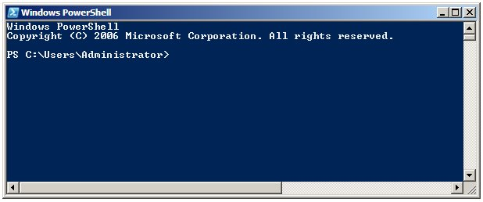
Running PowerShell
2006

Slide 11
Running PowerShell
2006

Slide 12
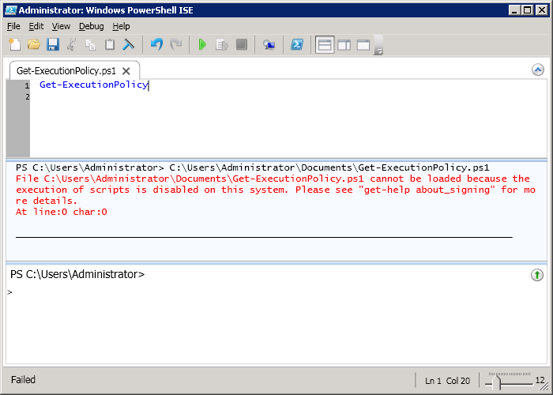
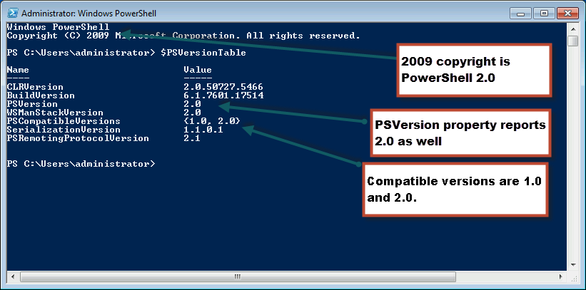
Running PowerShell
2010

Slide 13
Running PowerShell
2010

Slide 14
Running PowerShell
2010

Slide 15
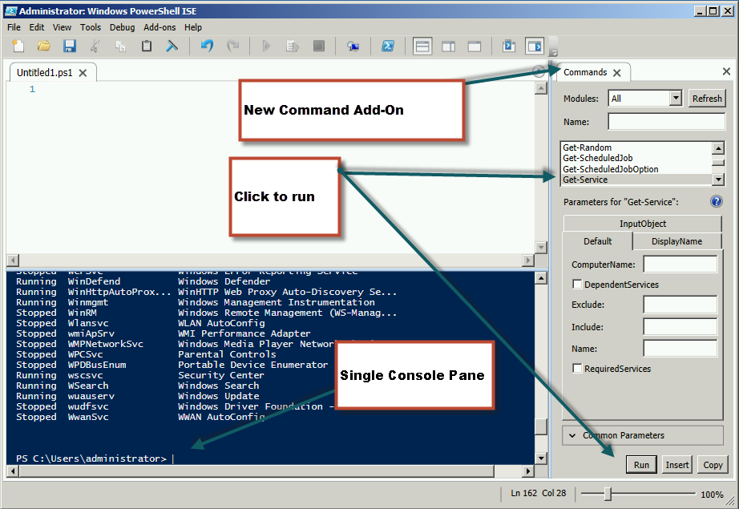
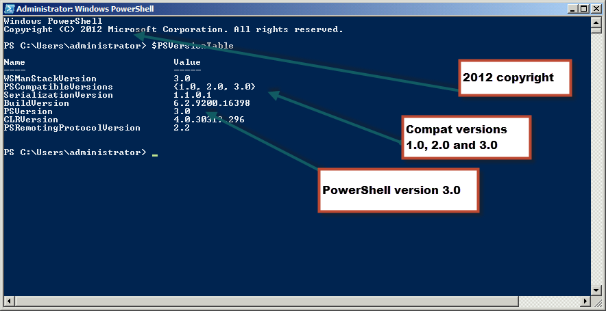
Running PowerShell
2012

Slide 16
Running PowerShell
2012

Slide 17
Running PowerShell
2012

Slide 18
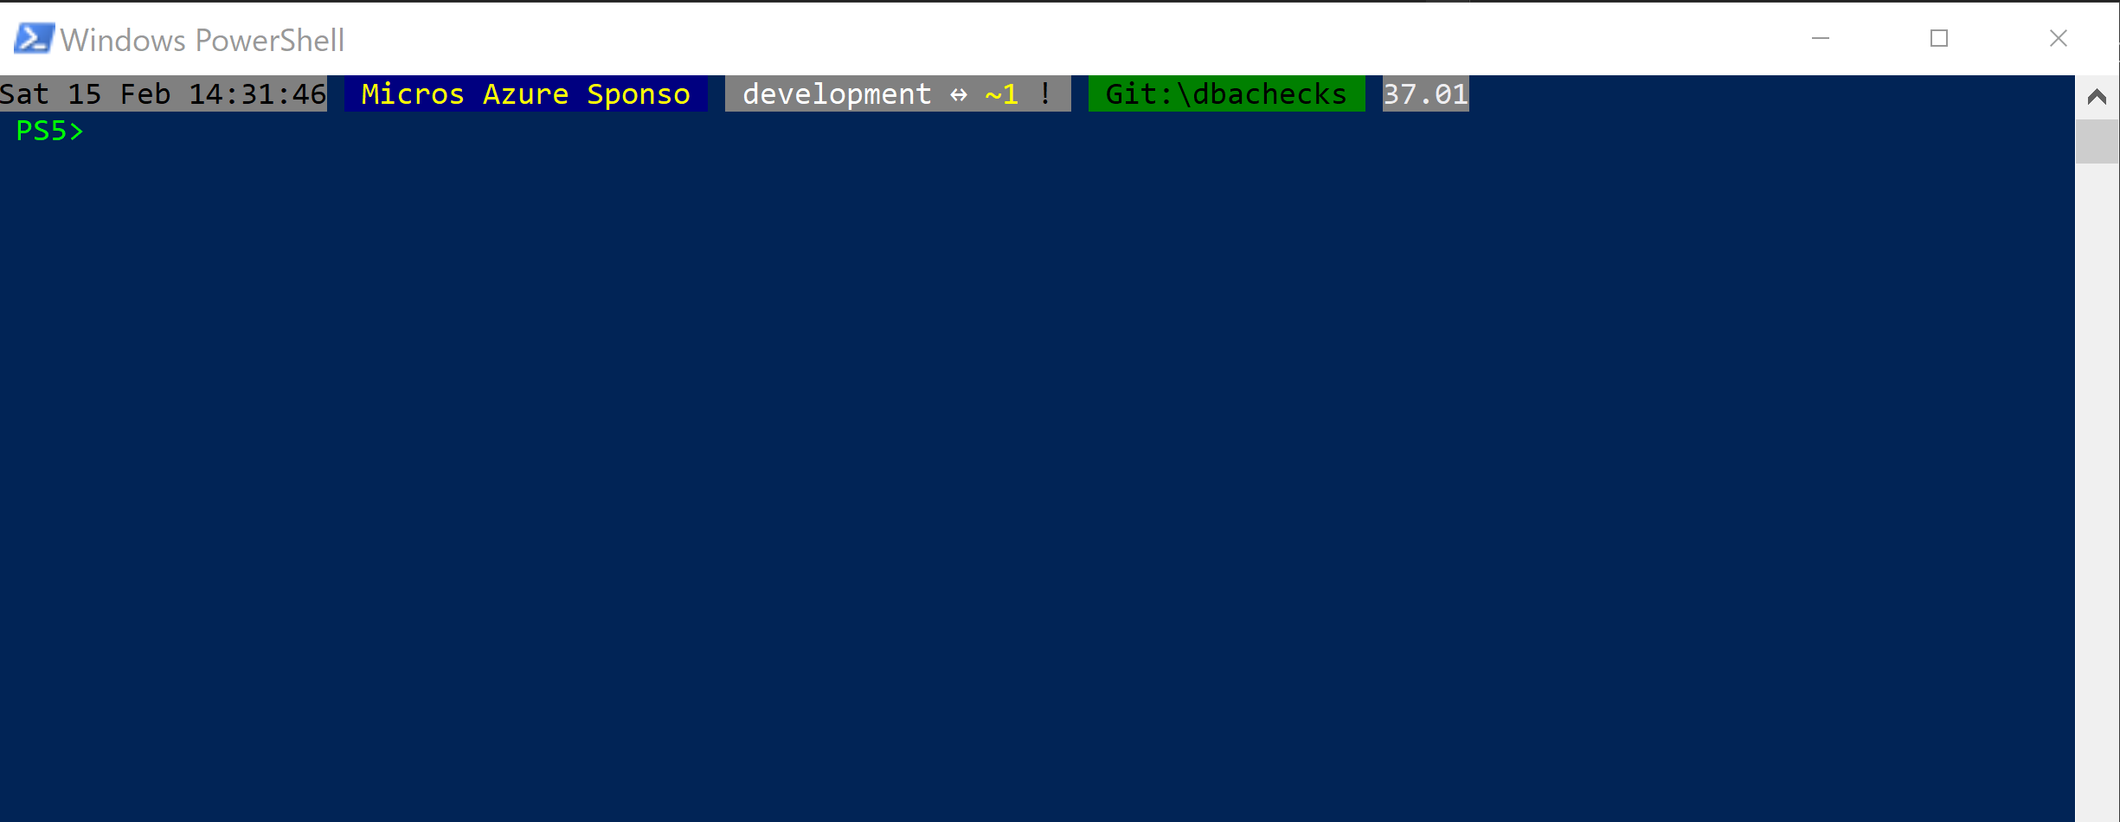
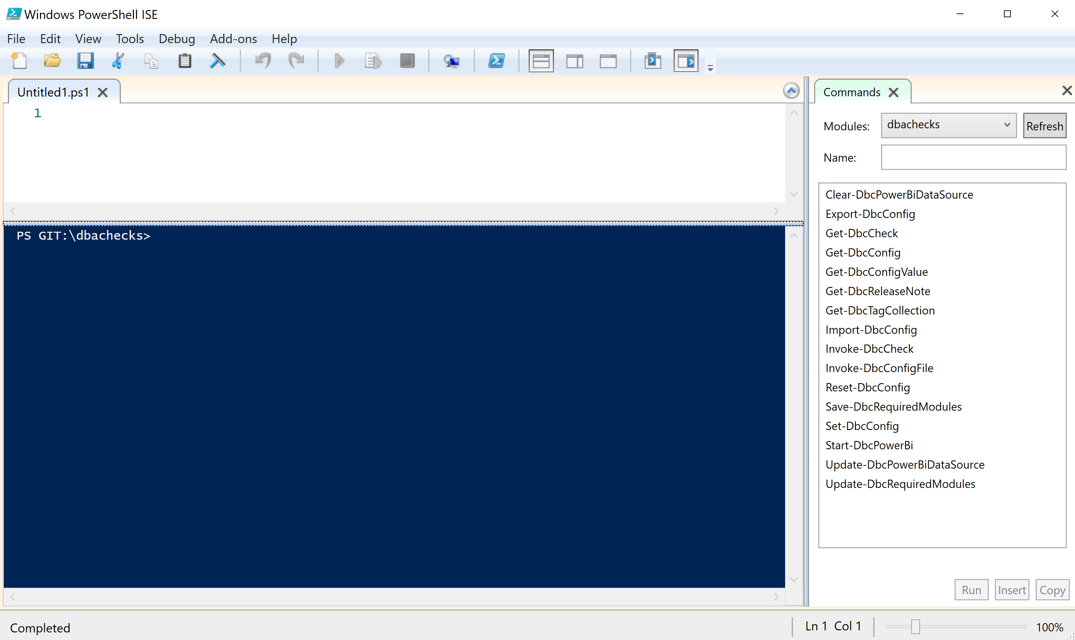
Running PowerShell
2017

Slide 19
Running PowerShell
2017

Slide 20
Running PowerShell
2017

Slide 21
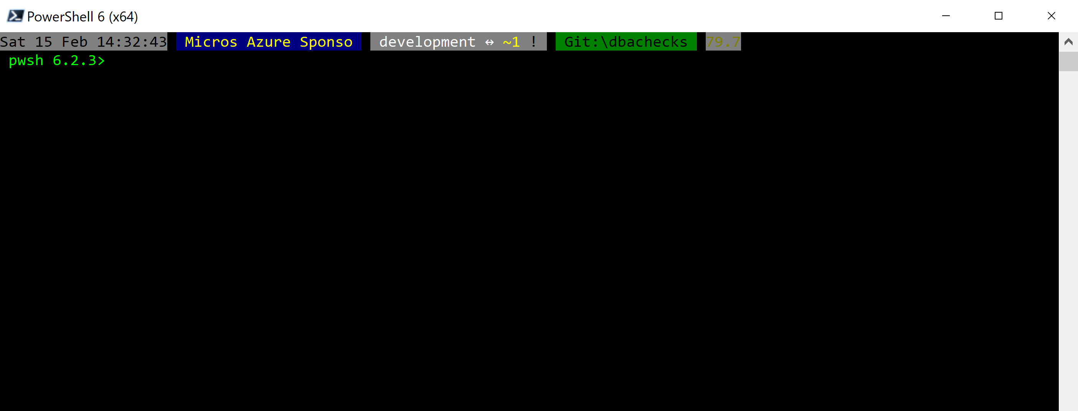
Running PowerShell
2018

Slide 22
Running PowerShell
2018

Slide 23
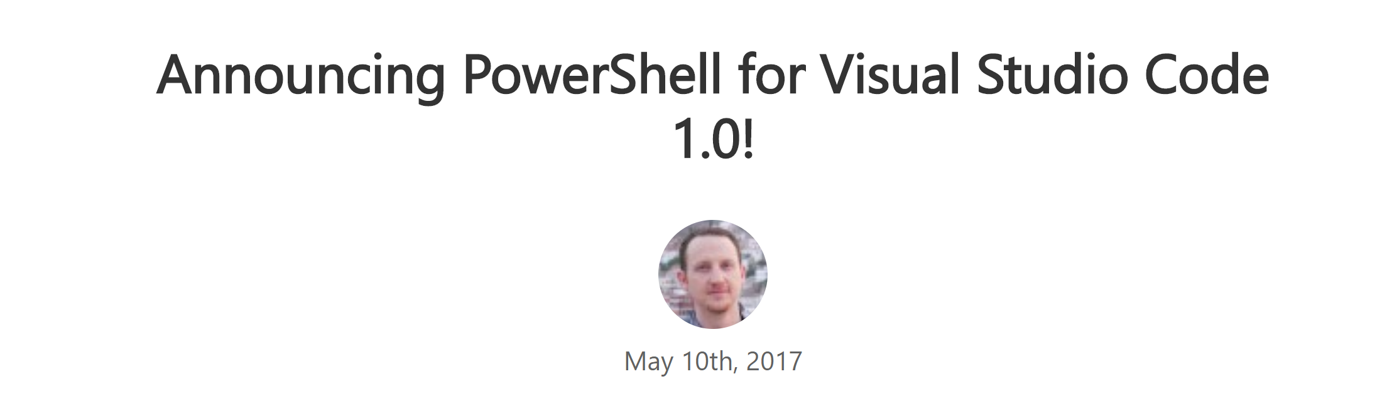
Running PowerShell
2016-17

Slide 24
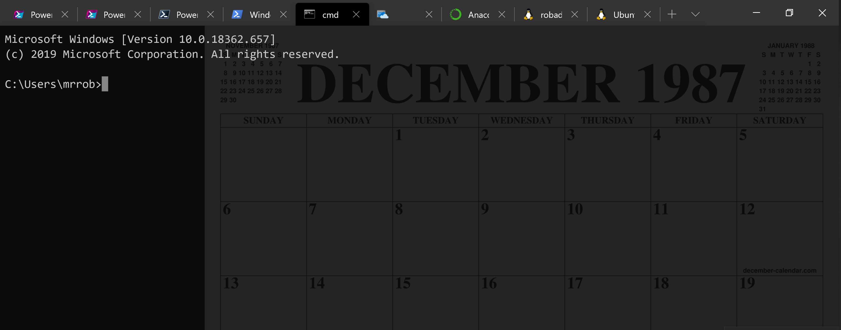
Running PowerShell
2016-17

Slide 25
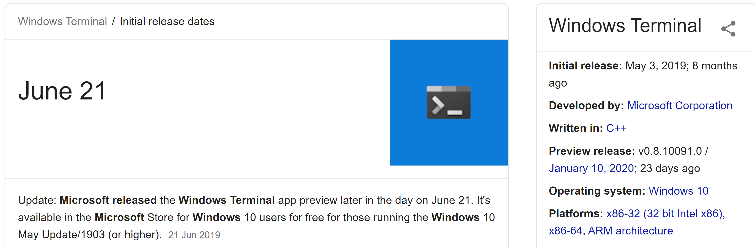
Running PowerShell
2019

Slide 26
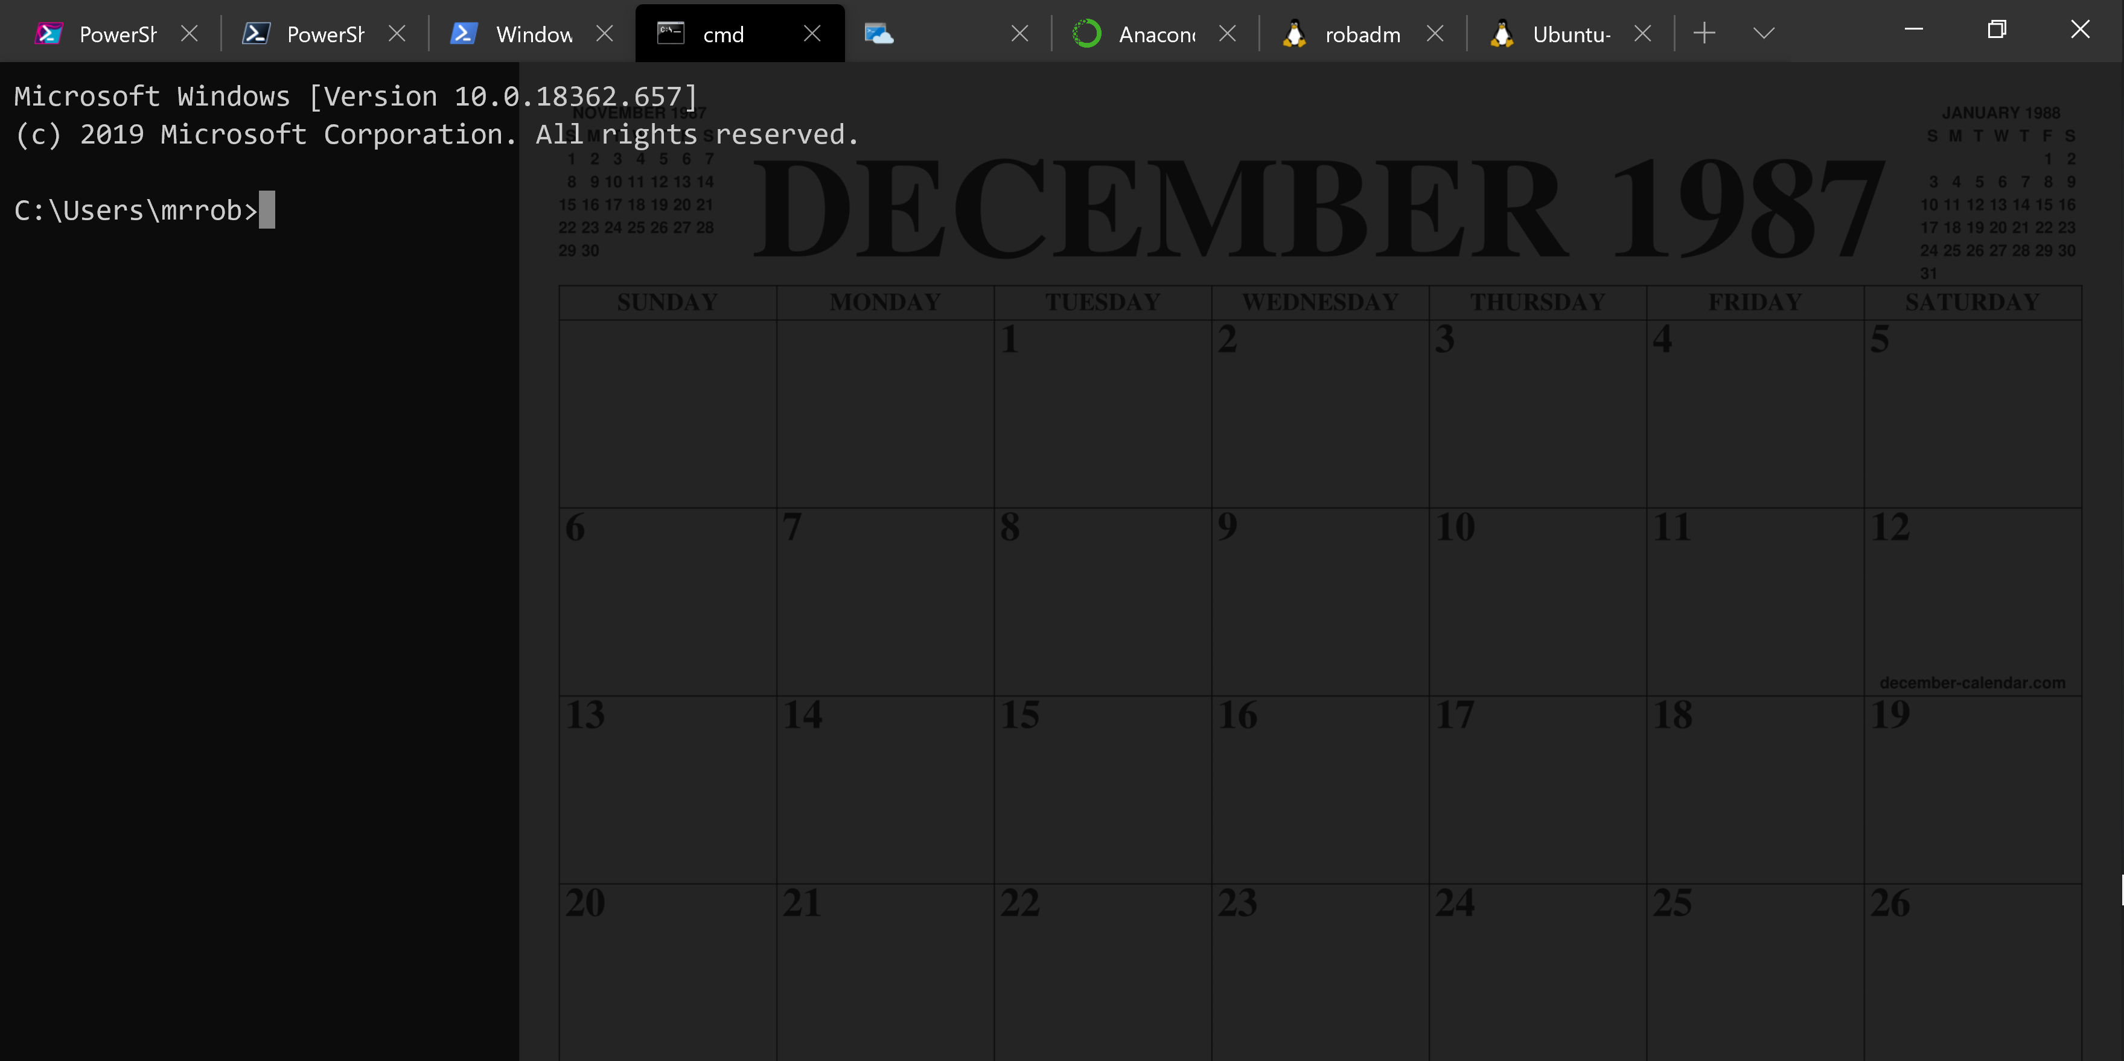
Running PowerShell
2019

Slide 27
Running PowerShell
2019

Slide 28
A Decade and a Half

Slide 29
Uh, Houston, we've had a problem
https://en.wikipedia.org/wiki/Houston,_we_have_a_problem

Slide 30
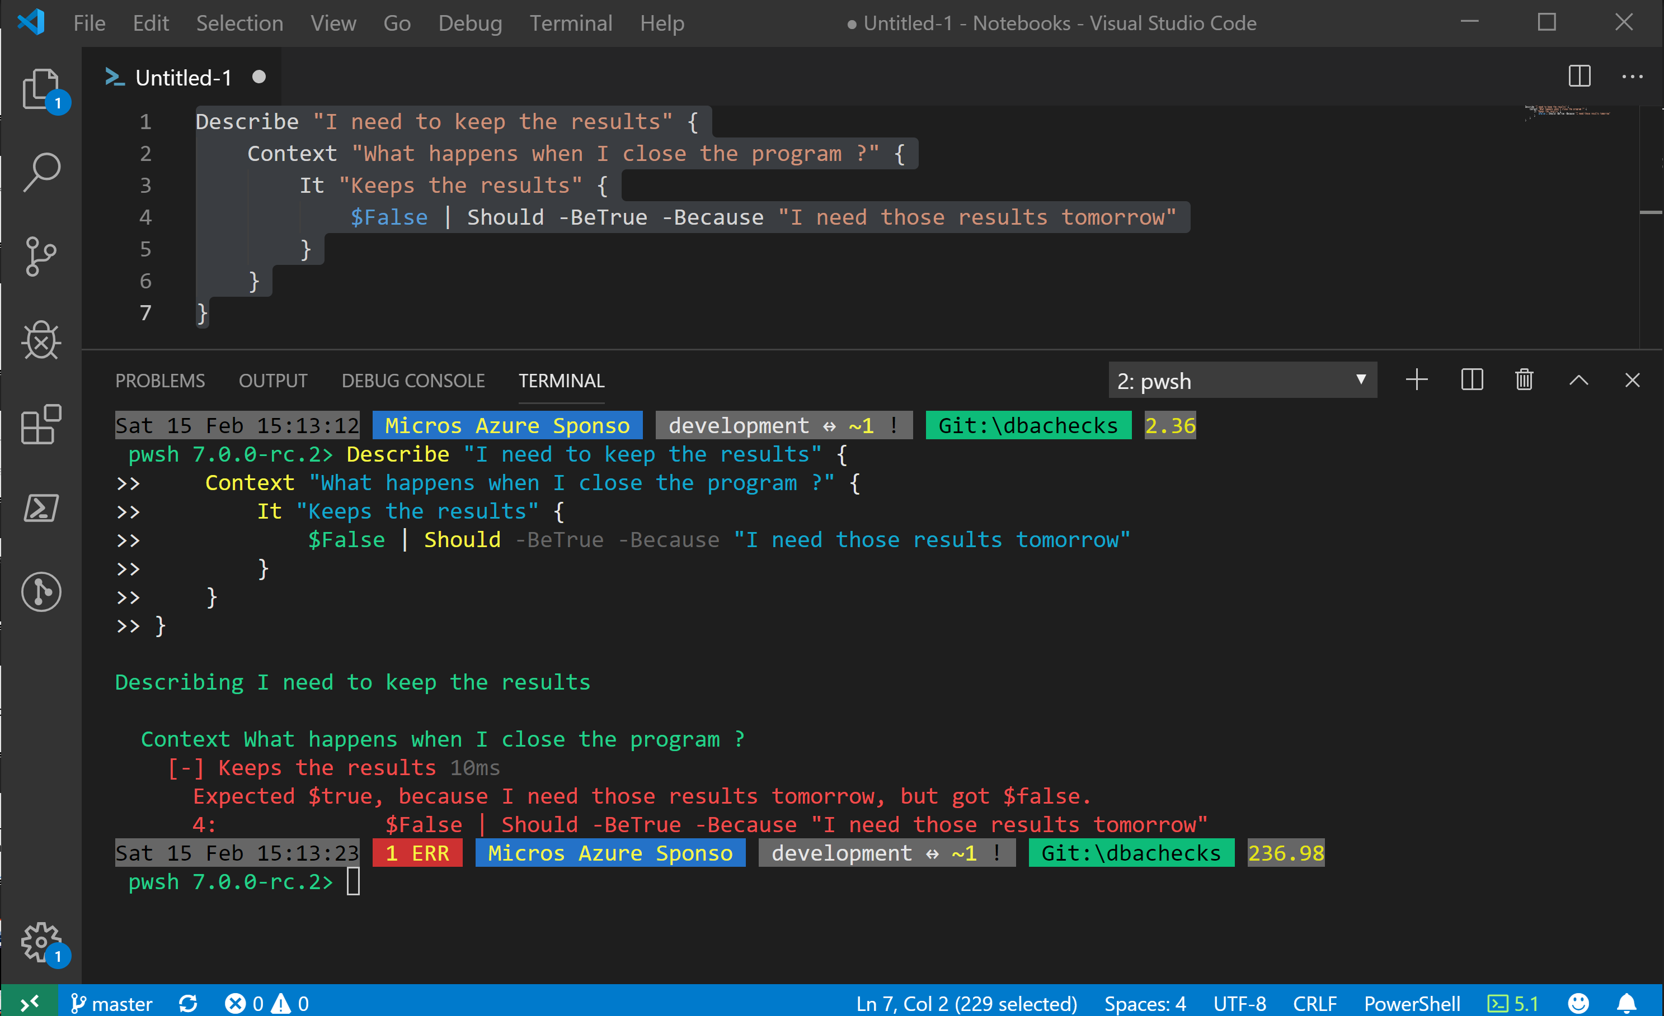
Without some effort………..

Slide 31
Without some effort………..

Slide 32
Without some effort………..

Slide 35


Slide 36


Slide 37
ALL
GONE

Slide 38
What is a Jupyter Notebook?
Document that can contain text, code, images and query results
@SQLDBAWithBeard SqlDbaWithABeard.com Rob Sewell beard.media/book

Slide 39
What is a Jupyter Notebook?
Document that can contain text, code, images and query results
@SQLDBAWithBeard SqlDbaWithABeard.com Rob Sewell beard.media/book

Slide 40
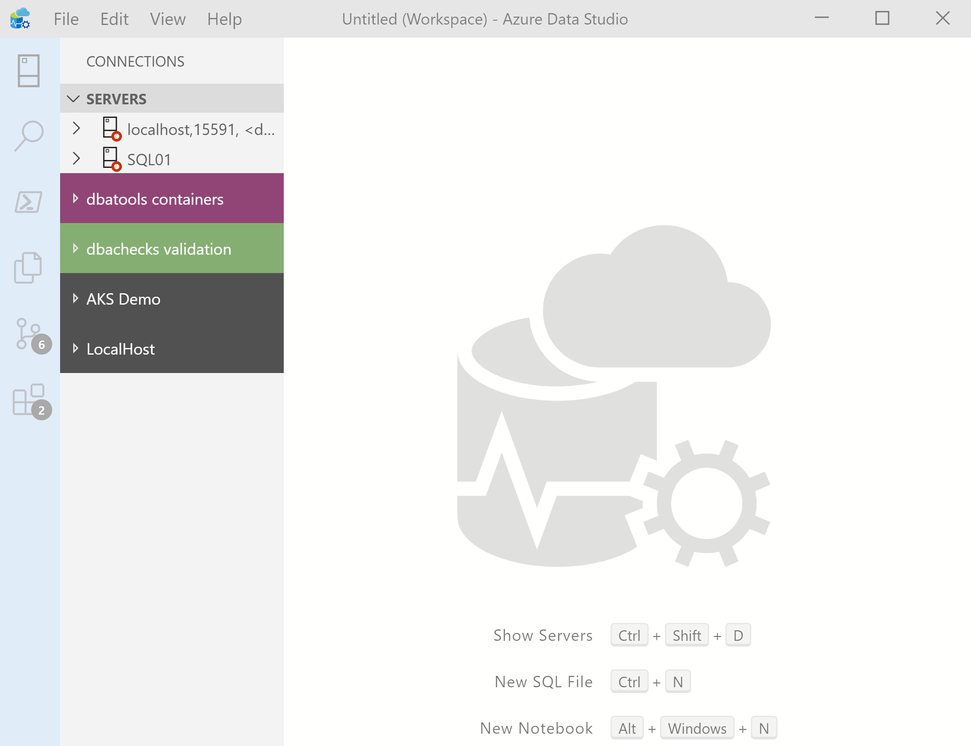

What’s Azure Data Studio ?
Cross Platform desktop environment for Data Professionals
@SQLDBAWithBeard SqlDbaWithABeard.com Rob Sewell beard.media/book

Slide 41
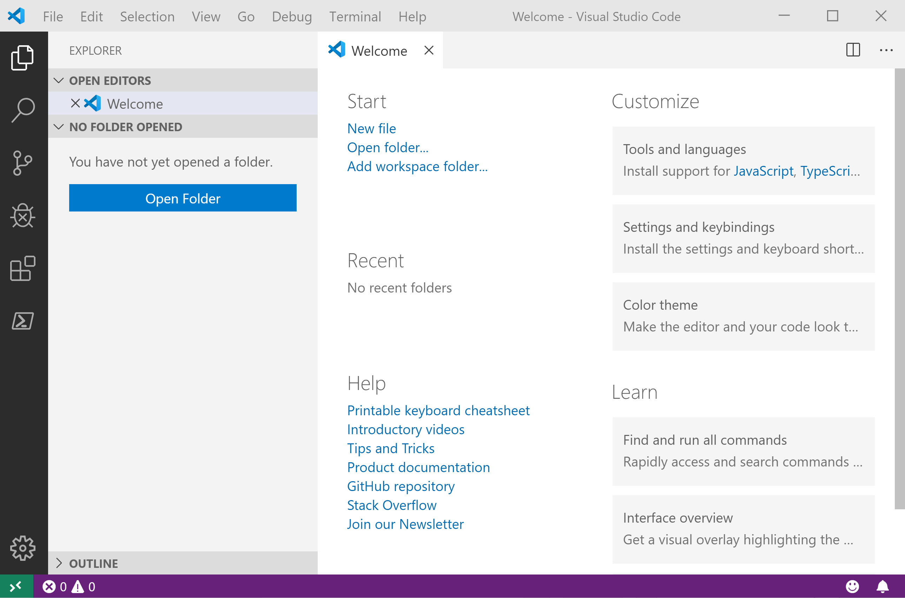
It Looks Like Visual Studio Code ?
@SQLDBAWithBeard SqlDbaWithABeard.com Rob Sewell beard.media/book

Slide 42
It Looks Like Visual Studio Code ?
@SQLDBAWithBeard SqlDbaWithABeard.com Rob Sewell beard.media/book

Slide 43
.NET Interactive Notebooks
Announced at Ignite but preview announced with PowerShell February 6th 2020 https://devblogs.microsoft.com/dotnet/net-interactive-is-here-net-notebooks-preview-2/
@SQLDBAWithBeard SqlDbaWithABeard.com Rob Sewell beard.media/book

Slide 44
.NET Interactive Notebooks
All the goodness of Jupyter Notebooks with added
PowerShell (and C#) (and F#)
@SQLDBAWithBeard SqlDbaWithABeard.com Rob Sewell beard.media/book

Slide 45
Notebook Mode in the PowerShell Preview extension for Visual Studio Code
https://devblogs.microsoft.com/powershell/public-preview-of-notebook-mode-in-the-powershell-preview-extension-for-visual-studio-code/
@SQLDBAWithBeard SqlDbaWithABeard.com Rob Sewell beard.media/book

Slide 46
Enough talk
Lets see it!
beard.media\book
@sqldbawithbeard
SQLDBAWithABeard.com
@SQLDBAWithBeard SqlDbaWithABeard.com Rob Sewell beard.media/book

